Slide 1
Humber parts
Rafil Yashooa – n0104049
Nov/29/2016

Slide 2
Introduction & Proposal
For our capstone project, we decided to go with the parts crib project database. This project interested me the most because it could help Humber’s part crib improve in a better way. The way it is designed is that it scans the student number, if the scan was successful, the pi would light an led and also play a beeping audio.
After the student number is scanned, we would send that data to the database and run the program again to scan the part numbers.

Slide 3
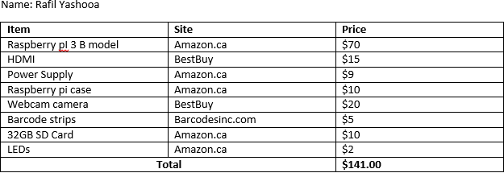
Project Budget
Update: added beep audio, led light from PCB board

Slide 4
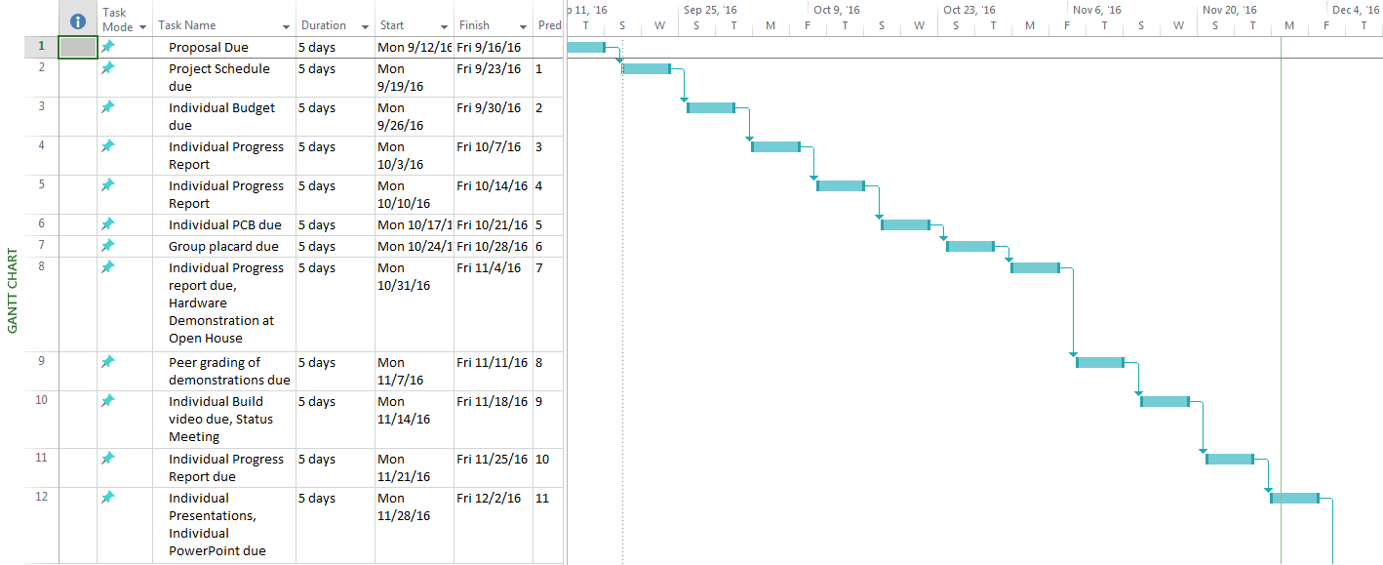
Project Schedule

Slide 5
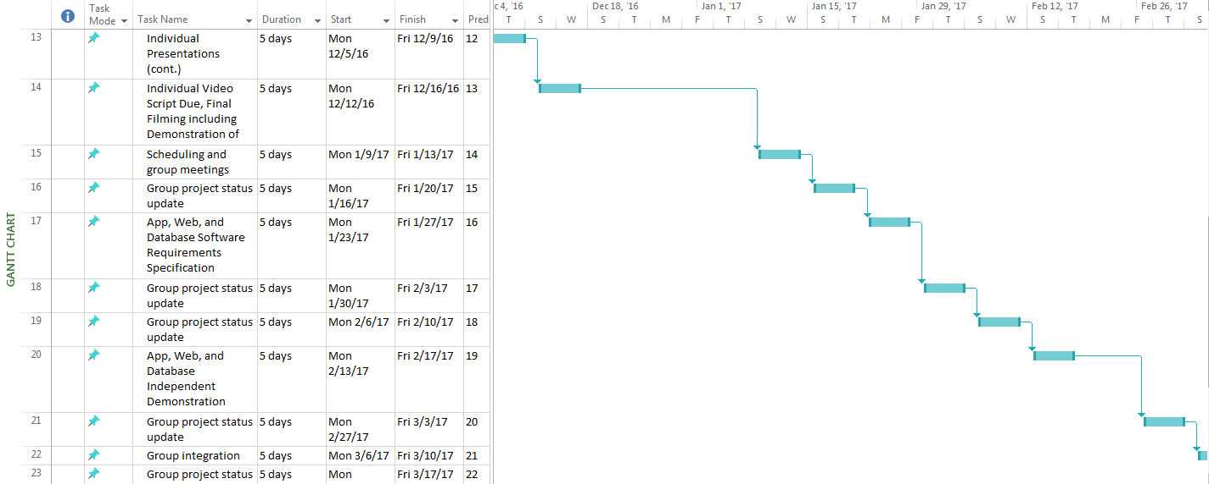
Project Schedule

Slide 6
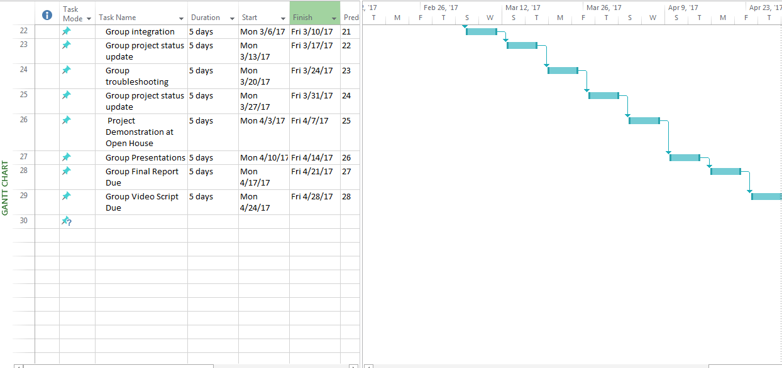
Project Schedule

Slide 7
Build Video
https://rafyo127.github.io/#Section_9

Slide 8
Course knowledge
CENG 320 - Network programming
Learned how to connect to database, create databases and so on
CENG Internals – CENG 251
Learned how to write C programs
Python
Main code for our project
CNEG 200 - Unix Scripting & CENG 320 Network Programming
Learned how to program in C

Slide 9
Project Demo

Slide 10
Thanks for watching !!

